Slide 1
1. Fine-grained Classification
2. 3D Human Pose Estimation
3. 3D Object Classification

Slide 2
Fine-Grained Classification
Problem: classify fine-grained categories
Like dogs’ category, Ford and Benz
Input: A single RGB image
Output: Label
Notes:
.

Slide 3
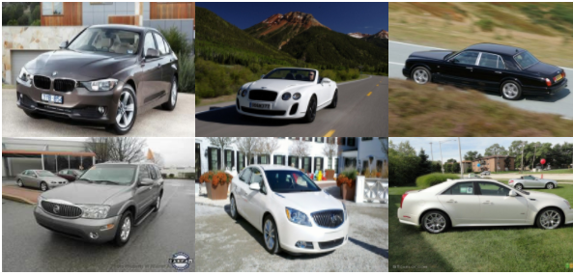
Fine-Grained Classification Benchmark: Standford Car
http://ai.stanford.edu/~jkrause/cars/car_dataset.html
Jonathan Krause, Michael Stark, Jia Deng, Li Fei-Fei
16,185 images of 196 classes of cars.

Slide 4
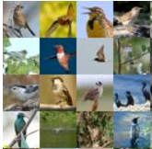
Fine-Grained Classification Benchmark: Caltech-UCSD Birds 200
http://www.vision.caltech.edu/visipedia/CUB-200.html
11,788 images of 200 classes of birds
15 Part Locations, 312 Binary Attributes, 1 Bounding Box

Slide 5
Text Information VS. Proposal
Text Information
Proposal
More Information
New BP equation
Find good proposal
Feature
Classification

Slide 6
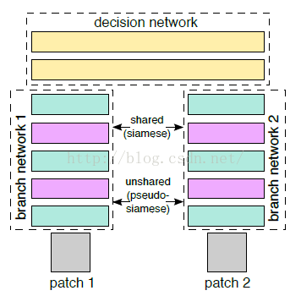
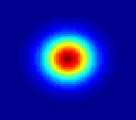
Two Key Techniques
Heatmap Network
Similarity Network

Slide 7
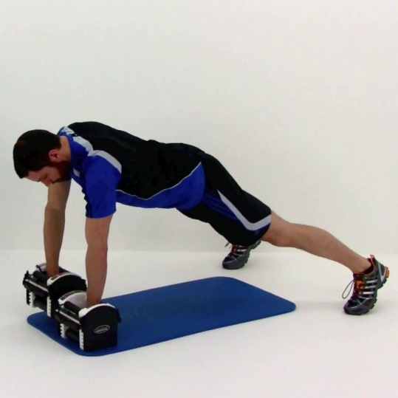
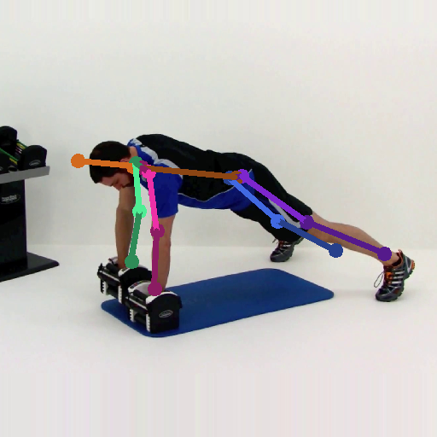
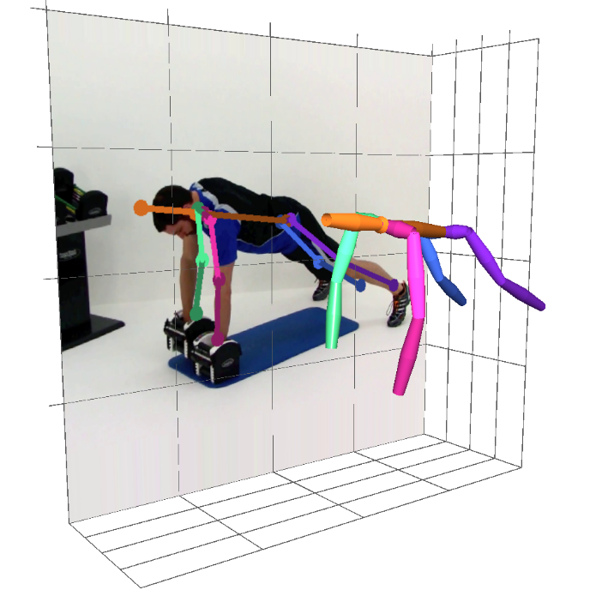
Human Pose Estimation
Problem: localize key points of a person
Input: a single RGB image
Output: 2D or 3D key points
RGB Image (person centered)
Pose Estimator
2D Key Points
3D Key Points
Notes:
The problem of human pose estimation is to localize the key points of a person.
The input is a single RGB image with a person in the image center.
Then a pose estimator is designed to output the location 2D or 3D key points of this person.

Slide 8
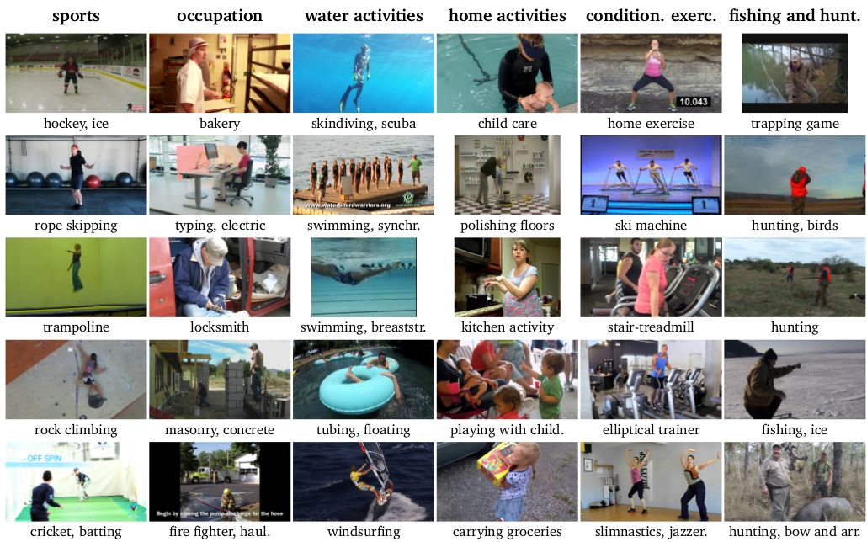
2D Pose Benchmark: MPII dataset
Andriluka et al., 2d human pose estimation: New benchmark and state of the art analysis, CVPR 2014
YouTube videos, 410 daily activities
Complex poses and appearances
25k images, 40k annotated 2D poses
Notes:
Let’s take a look at the state-of-the-art results on the 2D human pose benchmark MPII dataset

Slide 9
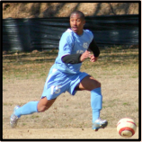
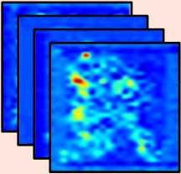
Detection VS. Regression
Detection
Regression
Per-pixel classification
Output: likelihood score maps
Location regression
Output: key points location
Notes:
There are two primary solutions for this problem in the literature. Detection based and regression based. Detection methods classify each pixel into key point classes and output the likelihood score maps, a maximum post-process is usually performed on these score maps to localize the key points. And regression methods directly regress the location of those key points.

Slide 10
Performance
Detection
Regression
Per-pixel classification
Output: likelihood score maps
Used in most 2D methods
State-of-the-art result
Location regression
Output: key points location
Only used in a few 2D methods
Unsatisfactory result
Notes:
However, the performance based on these two methods are quite different. Most of the state-of-the-art 2D human pose estimation methods are detection based, while only a few are regression based and the result is unsatisfactory.

Slide 11
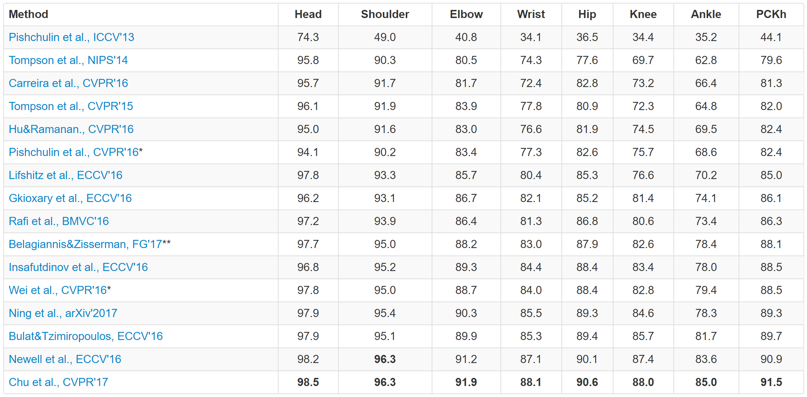
MPII Leader Board
Metric: percentage of correct keypoints (PCK). The higher, the better.
Only one regression method
Not competitive to detection
Notes:
This is the leaderboard of MPII.
And there is only one method that is regression based and the result is not competitive to the other detection based methods.

Slide 12
Generalization
Detection
Regression
Per-pixel classification
Output: likelihood score maps
Used in most 2D methods
State-of-the-art result
Hard to generalize to 3D task
Location regression
Output: key points location
Only used in a few 2D methods
Unsatisfactory result
General for both 2D and 3D task
Notes:
However the score maps are hard to generalize to 3D task, because the 3D score maps are too demanding for memory and computation. On the contrary, regression is more straightforward and general for both 2D and 3D tasks.

Slide 13
Motivation of this work
Detection
Regression
Per-pixel classification
Output: likelihood score maps
Used in most 2D methods
State-of-the-art result
Scoremaps are more expressive
Hard to generalize to 3D task
Location regression
Output: key points location
Only used in a few 2D methods
Unsatisfactory result
Dependency not well exploited
General for both 2D and 3D task
Notes:
Our motivation is to investigate how to make regression based methods better exploit the joint dependency. Since it is general for both 2D and 3D tasks.

Slide 14
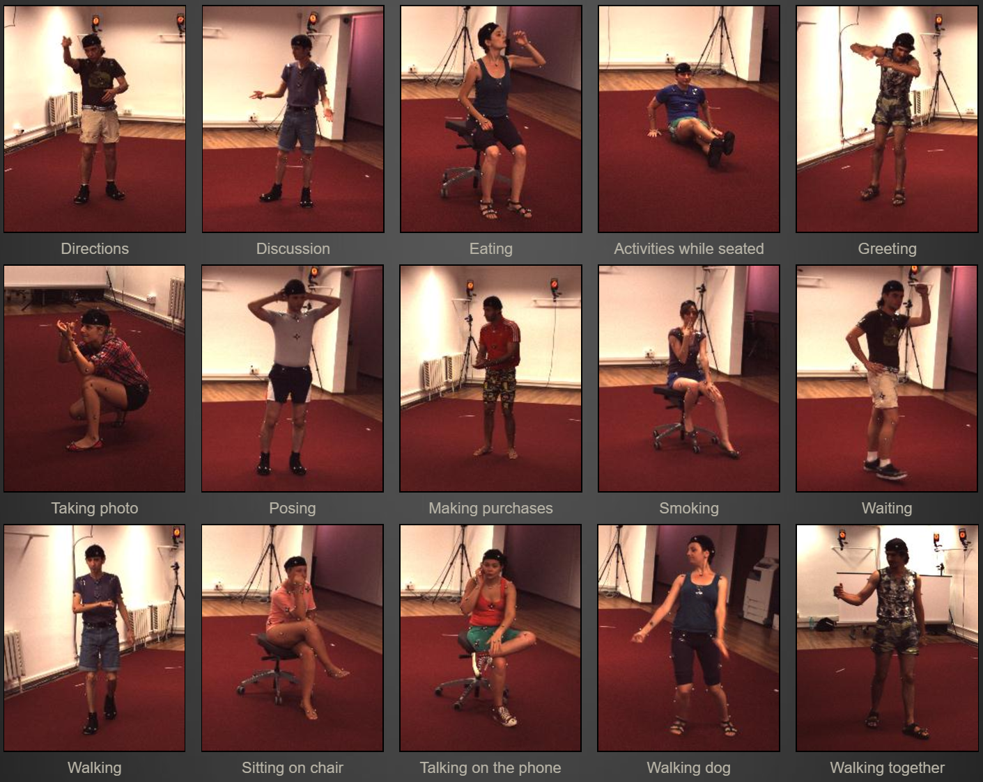
3D Pose Benchmark: Human 3.6M dataset
Lonescu et al., Human3.6m: Large scale datasets and predictive methods for 3d human sensing in natural environments, PAMI 2014
Ground truth by motion capture
7 subjects x 15 actions x 4 cameras
Millions of RGB frames
Notes:
First let’s take a look at the overall performance of our method on the 3D and 2D human pose benchmarks.

Slide 15
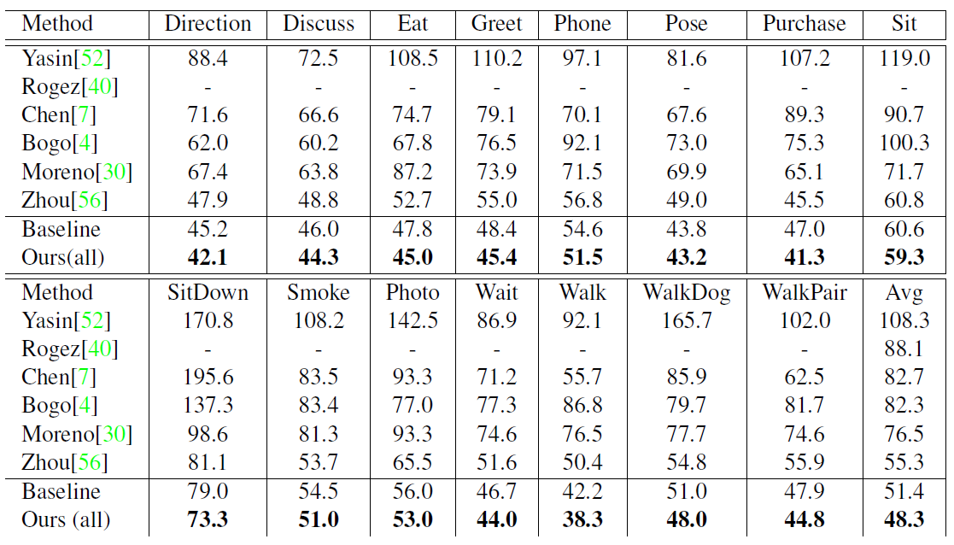
Our Performance (3D)
Dataset: Human3.6M.
Metrics: mean joint position error in mm. The lower, the better.
Advance the state-of-the-art a large margin, 12.7%.
A record of 48.3mm average joint error.
Notes:
In general, we have achieved the beset 3D human pose estimation performance.

Slide 16
Three Key Techniques
Unified 2D and 3D Pose Regression
Improve the Network
Bone based pose representation
Simplify the problem
Compositional loss function
Encodes long range interactions between bones
Notes:
Our method consists of two key techniques.
The first is a new bone based pose representation that simplify this problem.
And the second is a compositional loss function that encodes long range interactions between bones.

Slide 17
Unified 2D and 3D Pose Regression
Our method general for 3D and 2D task.
Easily mixed 3D and 2D data training:
Decompose the loss into xy part and z part.
xy part is always valid for both 3D and 2D samples.
z part is only computed for 3D samples and set to 0 for 2D samples.
Notes:
There is another by-product of our method.
Since our method is general for both 3D and 2D tasks. We can easily mix the 3D and 2D training. It is technically very simple.
We only need to decompose the loss into xy and z part….
This mixed training bring significant improvements to 3D pose performance. Because it makes use of both
Better image generalization from 2D data.
High 3D pose precision and variation from 3D data.
Another benefit is that it produces plausible and convincing 3D pose result on in-the-wild image.

Slide 18

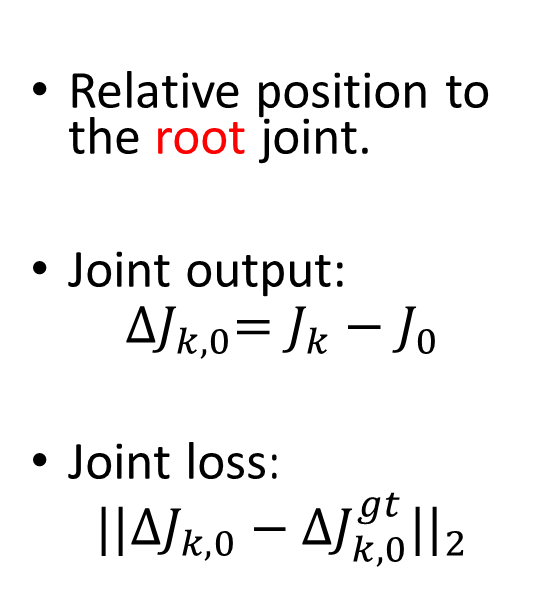
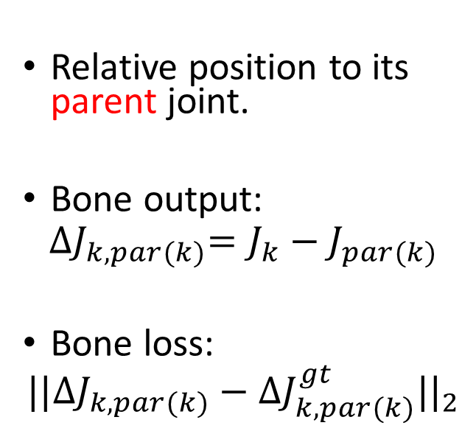
Pose Representation: Joint VS. Bone
Joint
Bone
Relative position to the root joint.
Joint output:
$${∆J}_{k,0}=J_{k}−J_{0}$$
Joint loss:
$${||{∆J}_{k,0}−{∆J}_{k,0}^{gt}||}_{2}$$
Relative position to its parent joint.
Bone output:
$${∆J}_{k,par(k)}=J_{k}−J_{par(k)}$$
Bone loss:
$${||{∆J}_{k,par(k)}−{∆J}_{k,par(k)}^{gt}||}_{2}$$
J0
J0
J1
J1
J2
J2
Notes:
First is a novel pose representation using bones.
Most previous regression works represent pose with the joint locations. Usually, a root joint is selected as origin. And the pose is defined as a relative position from one joint to this root joint.
The network will directly output joint positions and supervised by the joint position loss.
Instead, for the bone representation, a posed is defined as the relative position from one joint to its parent joint along the kinematic tree.
The network will output bone positions and is supervised by the bone position loss

Slide 19
Joint Representation: Drawbacks
Joints independently estimated
Internal structure not exploited
Geometric constraint not satisfied
Bone length not constant
Joint angle may out of range
Notes:
There are several drawbacks of the native joint representation.
First, joints are estimated independently.
the internal structure is not explicitly exploited.
And the Geometric constraint among these joints are not satisfied.
For example, the bone length is not constant and the joint angle may get out of range.

Slide 20

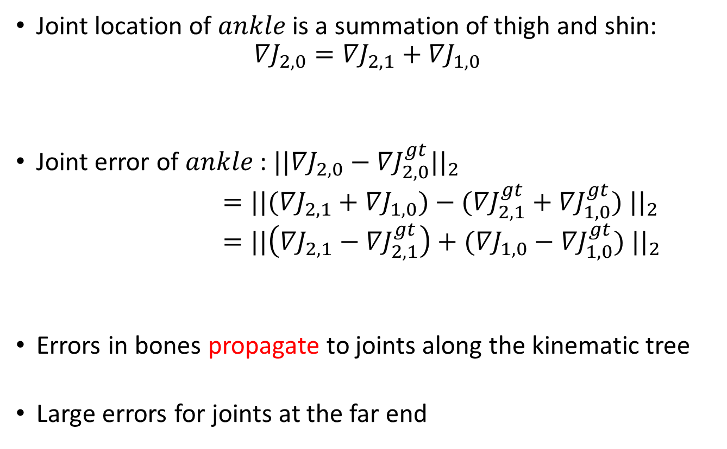




Use Bone Loss Only: Drawback
$$J_{0}^{gt}$$
Joint location of $ankle$ is a summation of thigh and shin:
$${∇J}_{2,0}={∇J}_{2,1}+{∇J}_{1,0}$$
Joint error of $ankle$: ${||{∇J}_{2,0}−{∇J}_{2,0}^{gt}||}_{2}$
$={||({∇J}_{2,1}+{∇J}_{1,0})−({∇J}_{2,1}^{gt}+{∇J}_{1,0}^{gt}) ||}_{2}$
$={||\left({∇J}_{2,1}−{∇J}_{2,1}^{gt}\right)+({∇J}_{1,0}−{∇J}_{1,0}^{gt}) ||}_{2}$
Errors in bones propagate to joints along the kinematic tree
Large errors for joints at the far end
Hip
bone 2
bone 1
$$J_{1}^{gt}$$
Knee
$$J_{1}^{}$$
$$J_{2}^{gt}$$
Ankle
Error in shin
Error in thigh
$$J_{2}^{}$$
Ground truth joint
Ground truth bone
Estimated bone
Notes:
Given so many advantages of bone representation. There is one drawback of using bone loss only.
For example, This is the ground truth of a simple pose with three joints hip, knee, ankle and two bones thigh and shin. Then, the network will predict two bones in orange.
But if we consider about the joint error of ankle. It is effected by both of the estimated thigh and shin. Since the joint location of ankle is a summation of the thigh and shin.
In other words, errors in bones propagate to joints along the kinematic tree.
This will cause large errors for joints at the far end.

Slide 21
Motivation
Besides local bone loss only
Long-range losses should also be considered and balanced over the intermediate bones.

Slide 22
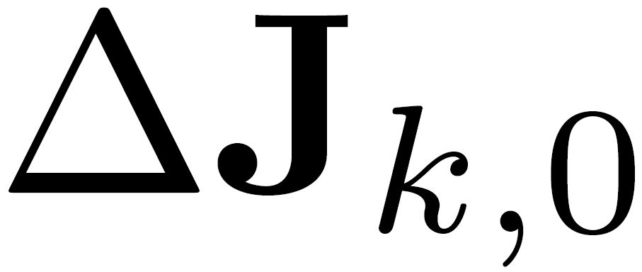
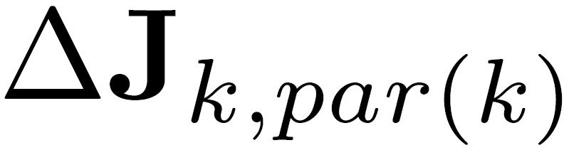
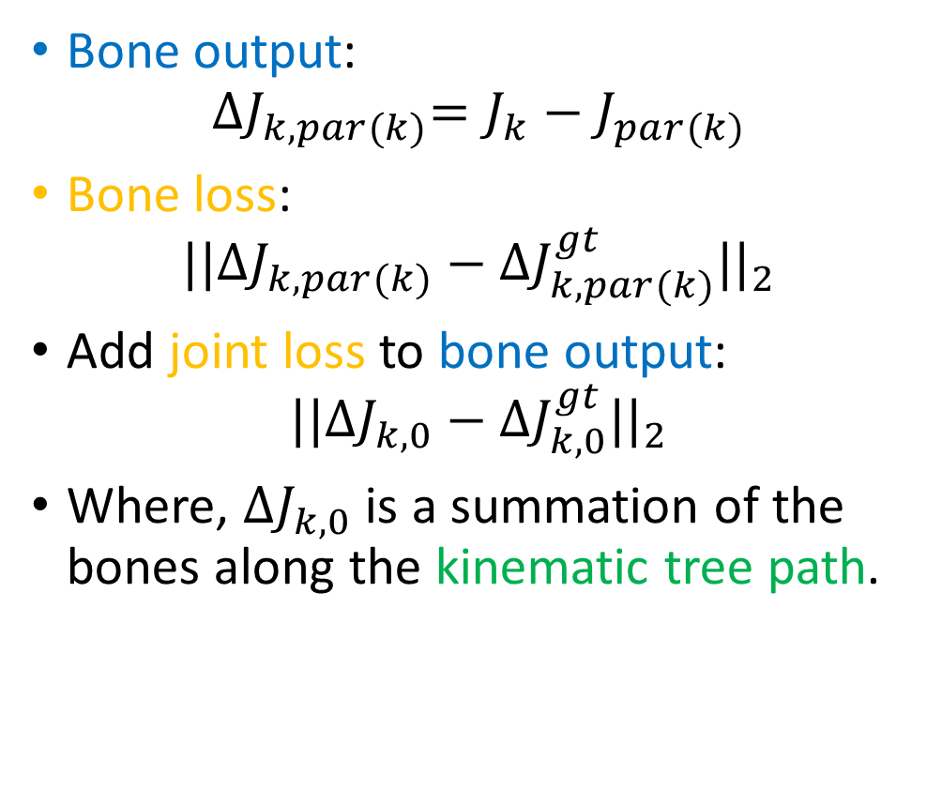

Add Joint Loss to Bone Outputs
Bone output:
$${∆J}_{k,par(k)}=J_{k}−J_{par(k)}$$
Bone loss:
$${||{∆J}_{k,par(k)}−{∆J}_{k,par(k)}^{gt}||}_{2}$$
Add joint loss to bone output:
$${||{∆J}_{k,0}−{∆J}_{k,0}^{gt}||}_{2}$$
Where, ${∆J}_{k,0}$ is a summation of the bones along the kinematic tree path.
$$J_{0}^{}$$
Notes:
So, it is quite intuitive for us to add joint loss to the bone outputs
Given the output bones,
The native bone loss is added to the individual bones.
And we can also add joint loss to the output bones
Because a joint position is a summation of the bones along the kinematic tree path.

Slide 23
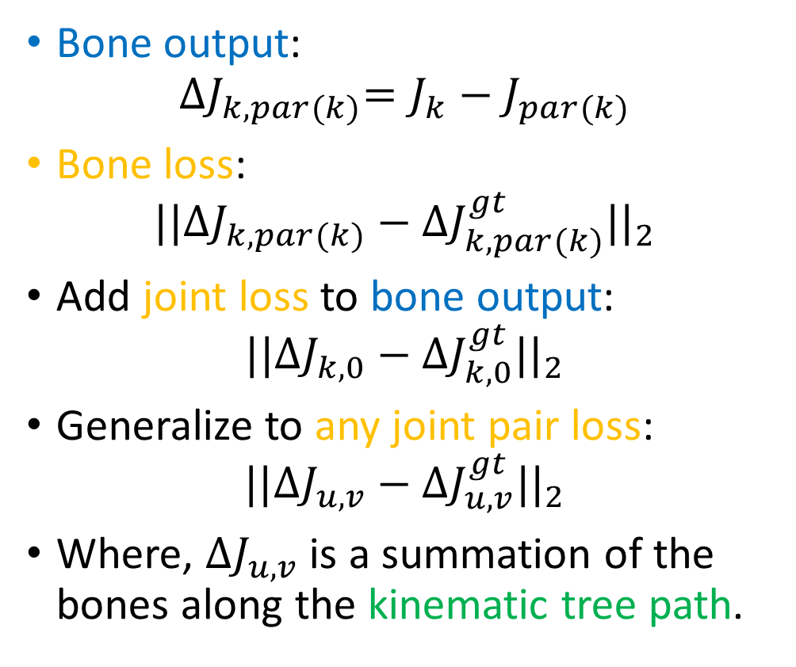
Generalize to Any Joint Pair Loss
Bone output:
$${∆J}_{k,par(k)}=J_{k}−J_{par(k)}$$
Bone loss:
$${||{∆J}_{k,par(k)}−{∆J}_{k,par(k)}^{gt}||}_{2}$$
Add joint loss to bone output:
$${||{∆J}_{k,0}−{∆J}_{k,0}^{gt}||}_{2}$$
Generalize to any joint pair loss:
$${||{∆J}_{u,v}−{∆J}_{u,v}^{gt}||}_{2}$$
Where, ${∆J}_{u,v}$ is a summation of the bones along the kinematic tree path.
Notes:
Moreover, the joint location loss can be generalized to any joint pair loss. The position the joint pair is also a summation of the bones along the kinematic tree path.

Slide 24
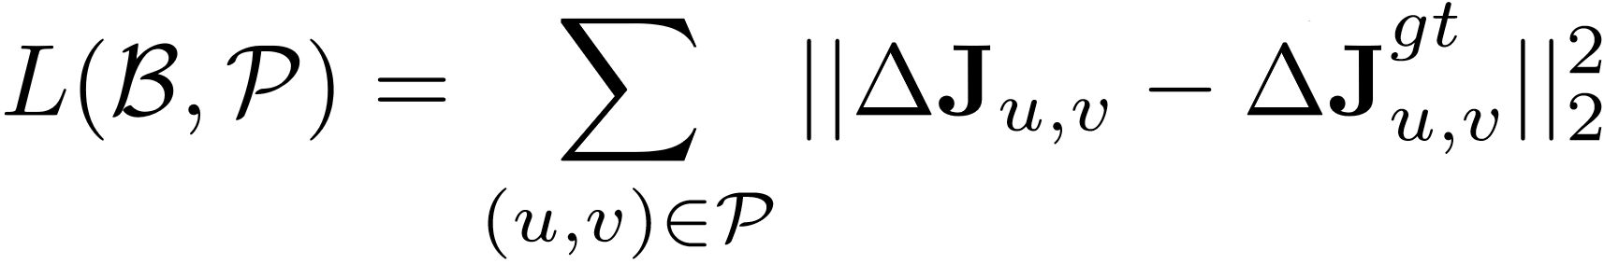
Compositional Loss Function
Regression output: bones
Ground truth relative position
Joint pair set
Relative position of a joint pair, a summation of the bones along the kinematic tree.
The long-range joint pair losses are considered and balanced over the intermediate bones!
The ground truth is sufficiently exploited!
Notes:
Finally, this is the formal definition of our compositional function. Given the bone outputs, and a joint pair set. The relative position of those joint pairs are supervised by the ground truth.
Note that the joint pair position is composed by the bones.
In this way, the long-range joint pair losses are considered and balanced over the intermediate bones.

Slide 25
Comparison Experiments
Network: 50-layer ResNet
Dataset:
3D benchmark: Human3.6M
2D benchmark: MPII
Methods:
Notation
Outputs
Loss
State
-
of
-
the
-
art
-
-
Our Baseline
Joints
Joint position
loss
Ours (bone)
Bones
Bone position
loss
Ours (all)
Bones
All joint pair position
loss
Notes:
Let’s do some comparison experiments to justify the efficiency of our techniques.
All of our experiments use the 50-layer resnet architecture.
Evaluated on the standard 2D and 3D benchmark are used
We compare our result with the state of the art.
We also implement a baseline using joint representation and joint position loss.
We compare the bone representation and bone loss only with the baseline to justify the efficiency of bone representation.
Then we add compositional loss function to it justify its efficiency.

Slide 26
3D Human Pose Results
A strong baseline, already state-of-the-art.
Bone representation is superior to joint.
Compositional loss function is effective.
[1] Zhou et al., Deep kinematic pose regression, ECCV 2016.
Metric
State of the art
Baseline
Ours (bone)
Ours (all)
Joint Error (mm)
78.7 [1]
75.0
75.0
(0.0%)
67.5
(
10.0%
)
The lower, the better
Bone Error (mm)
-
65.5
62.3
58.4
(4.9%)
(
10.8%
)
Bone
Std
(mm)
-
26.4
21.9
(17.0%)
21.7
(
17.8%
)
Illegal Angle (%)
-
3.7%
3.3%
(10.8%)
2.5%
(
32.4%
)

Slide 27
3D Object Classification
Problem: classification 3d object
Input: Point Cloud
Output: Label

Slide 28
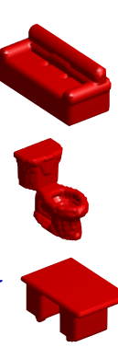
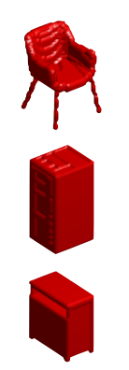
3D Object Classification Benchmark: ModelNet
http://modelnet.cs.princeton.edu/
All : 151128 3D CAD models belonging to 660 unique object categories
ModelNet-40: 12311 3D CAD models from 40 categories

Slide 29
Multi-View VS. Volume & Point Net
Multi-View
Volume Represent
Project Point Cloud to Multi-View
Input: A set of images of an object different views
Using Point Cloud to generate volume represent
Input: volume
Point Cloud Represent
Using Point Cloud Represent
Input: Point Cloud
Notes:
There are two primary solutions for this problem in the literature. Detection based and regression based. Detection methods classify each pixel into key point classes and output the likelihood score maps, a maximum post-process is usually performed on these score maps to localize the key points. And regression methods directly regress the location of those key points.

Slide 30
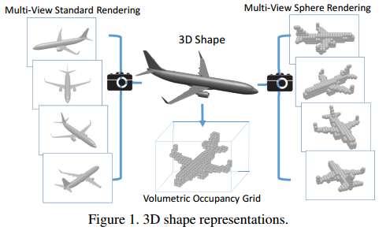
Multi-View VS. Volume & Point Net
Notes:
There are two primary solutions for this problem in the literature. Detection based and regression based. Detection methods classify each pixel into key point classes and output the likelihood score maps, a maximum post-process is usually performed on these score maps to localize the key points. And regression methods directly regress the location of those key points.

Slide 31
Performance
Multi-View
Volume Represent
Muti-View Feature
Classification
Dominant Set Clustering and Pooling for Multi-View 3D Object Recognition
CNNS
Volumetric and Multi-View CNNs for Object Classification on 3D Data
Point Cloud Represent
PointNet
PointNet Deep Learning on Point Sets for 3D Classification and Segmentation
Notes:
There are two primary solutions for this problem in the literature. Detection based and regression based. Detection methods classify each pixel into key point classes and output the likelihood score maps, a maximum post-process is usually performed on these score maps to localize the key points. And regression methods directly regress the location of those key points.

Slide 32
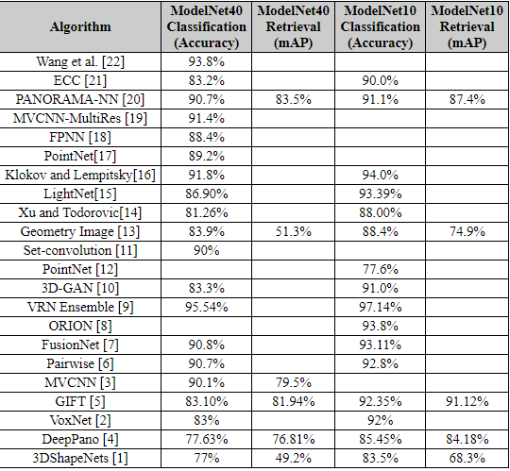
Model-Net
Point Cloud
Volume
Multi-view

Slide 33
Thanks!

